Slide 1
Entity-Relationship Modeling
Sumber: Silberschatz, Korth and Sudarshan, Database System Concepts, 6th Ed.
Program Studi Teknik Informatika
Institut Teknologi Bandung

Slide 2
Learning Outcomes
Define the fundamental terminology used in the ER data model
Describe the basic principles of the ER data model
Apply the basic modeling concepts and notation of the ER data model
Apply the advance modeling concepts and notation of the ER data model

Slide 3
Entity Sets
A database can be modeled as:
a collection of entities,
relationship among entities.
An entity is an object that exists and is distinguishable from other objects.
People: employee, student, patient
Place: store, warehouse, state
Object: machine, building, automobile
Event: sale, registration, renewal
Concept: account, course, work center
Entities have attributes
Example: people have names and addresses
An entity set is a set of entities of the same type that share the same properties.
Example: set of all persons, companies, trees, holidays

Slide 4
What Should an Entity Be?
SHOULD BE:
An object that will have many instances in the database
An object that will be composed of multiple attributes
An object that we are trying to model
SHOULD NOT BE:
A user of the database system (e.g., a treasurer)
An output of the database system (e.g., a report)

Slide 5
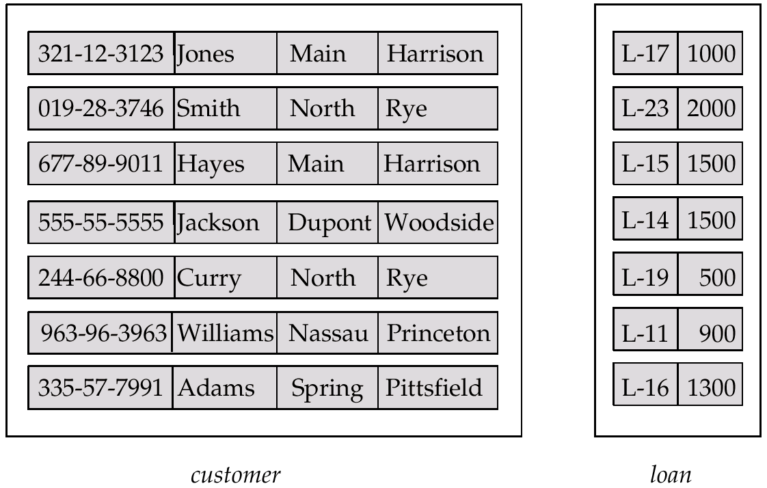
Entity Sets customer and loan
customer-id customer- customer- customer- loan- amount name street city number

Slide 6
Attributes
An entity is represented by a set of attributes, that is descriptive properties possessed by all members of an entity set.
Domain – the set of permitted values for each attribute
Attribute types:
Simple and composite attributes.
Single-valued and multi-valued attributes
Derived attributes
Example:
customer = (customer-id, customer-name, customer-street, customer-city) loan = (loan-number, amount)
Notes:
- Possessed = semua instan/record punya property ITU

Slide 7
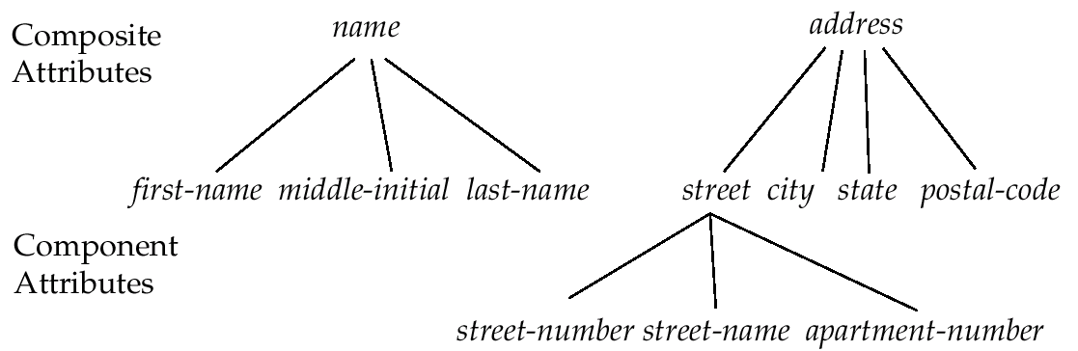
Composite Attributes

Slide 8
Relationship Sets
A relationship is an association among several entities
Example: Hayes depositor A-102 customer entity relationship set account entity
A relationship set is a mathematical relation among n ≥ 2 entities (possibly nondistinct), each taken from entity sets
{(e₁, e₂, … e_{n}) | e₁ ∈ E₁, e₂ ∈ E₂, …, e_{n} ∈ E_{n}} where (e₁, e₂, …, e_{n}) is a relationship
Example: (Hayes, A-102) ∈ depositor

Slide 9
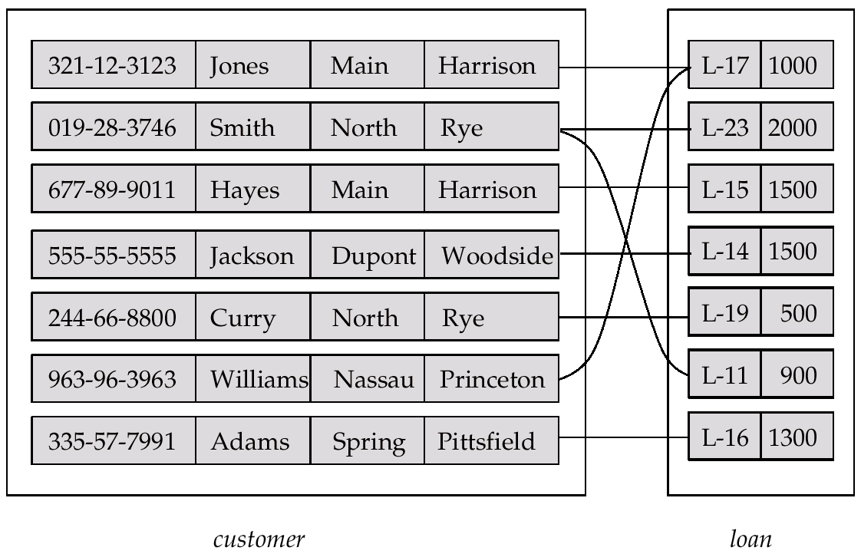
Relationship Set borrower

Slide 10
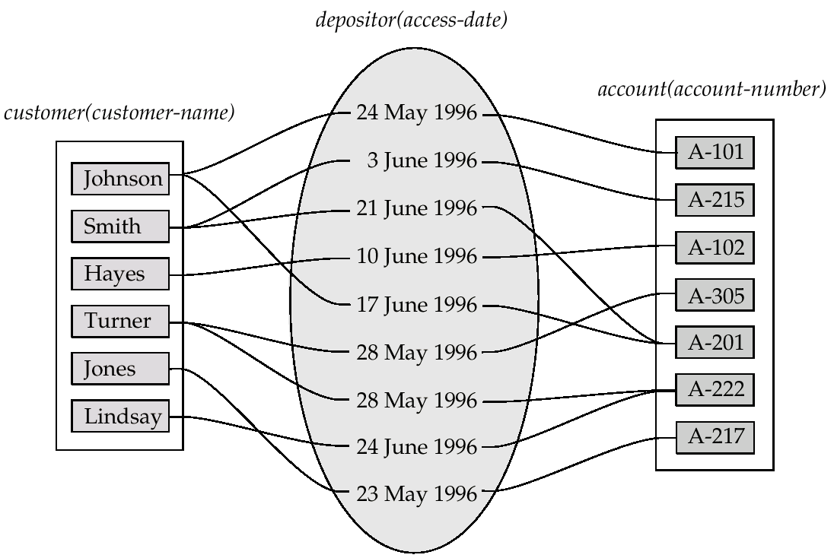
Relationship Sets (Cont.)
An attribute can also be property of a relationship set.
For instance, the depositor relationship set between entity sets customer and account may have the attribute access-date

Slide 11
Degree of a Relationship Set
Refers to number of entity sets that participate in a relationship set.
Relationship sets that involve two entity sets are binary (or degree two). Generally, most relationship sets in a database system are binary.
Relationship sets may involve more than two entity sets.
Relationships between more than two entity sets are rare. Most relationships are binary. (More on this later.)
Example: students work on research projects under the guidance of an instructor.
relationship proj_guide is a ternary relationship between instructor, student, and project
Notes:
Involve = terdiri

Slide 12
Mapping Cardinalities
Express the number of entities to which another entity can be associated via a relationship set.
Most useful in describing binary relationship sets.
For a binary relationship set the mapping cardinality must be one of the following types:
One to one
One to many
Many to one
Many to many

Slide 13
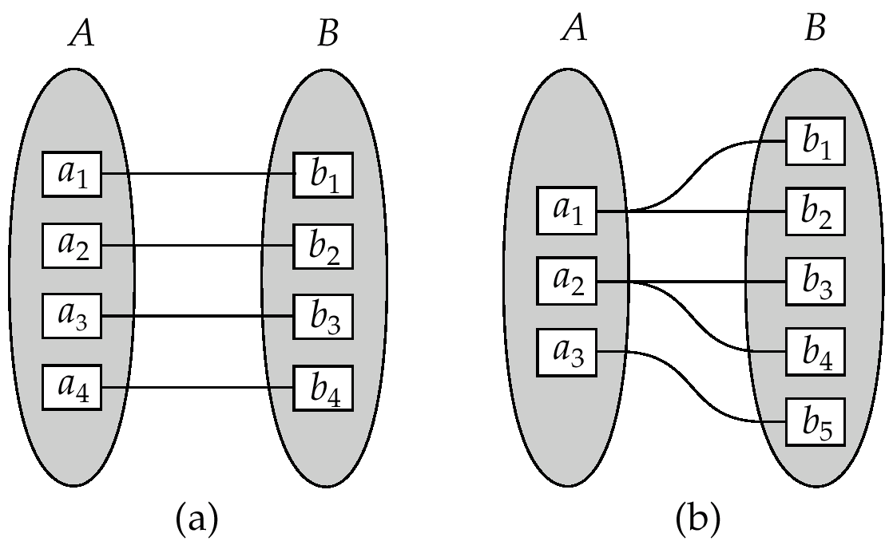
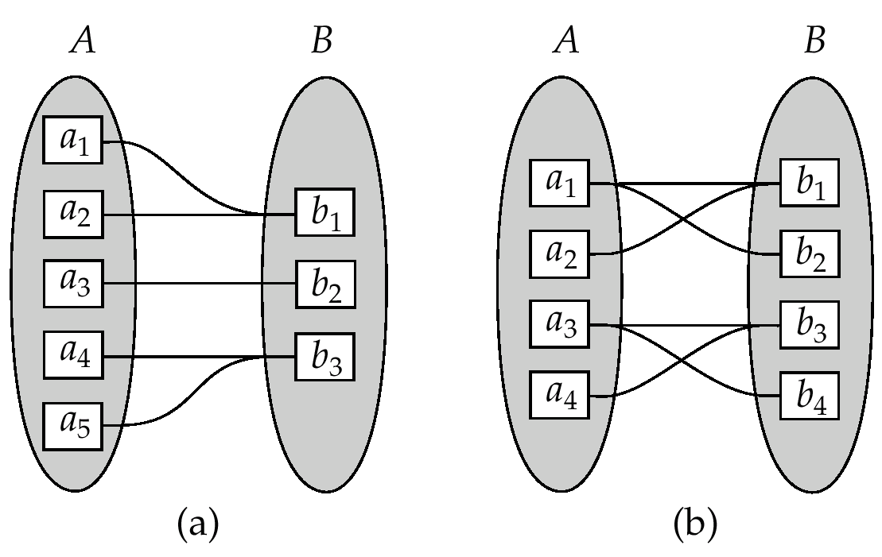
Mapping Cardinalities (Cont.)
One to one
One to many
Many to one
Many to many
Notes:
Note: Some elements in A and B may not be mapped to any
elements in the other set

Slide 14
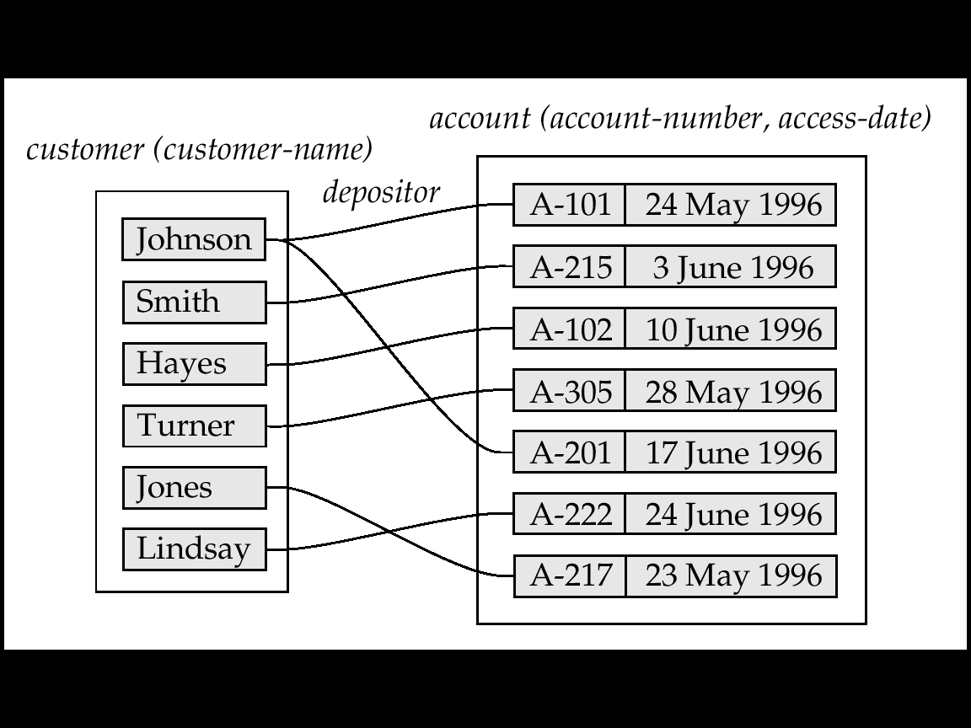
Mapping Cardinalities affect ER Design
Can make access-date an attribute of account, instead of a relationship attribute, if each account can have only one customer
I.e., the relationship from account to customer is many to one, or equivalently, customer to account is one to many

Slide 15
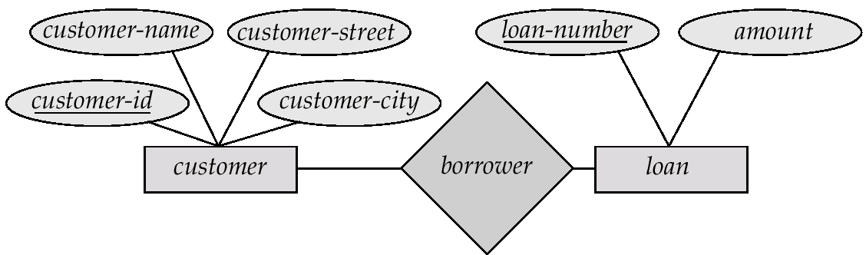
E-R Diagrams
Rectangles represent entity sets.
Diamonds represent relationship sets.
Lines link attributes to entity sets and entity sets to relationship sets.
Ellipses represent attributes
Double ellipses represent multivalued attributes.
Dashed ellipses denote derived attributes.
Underline indicates primary key attributes (will study later)

Slide 16
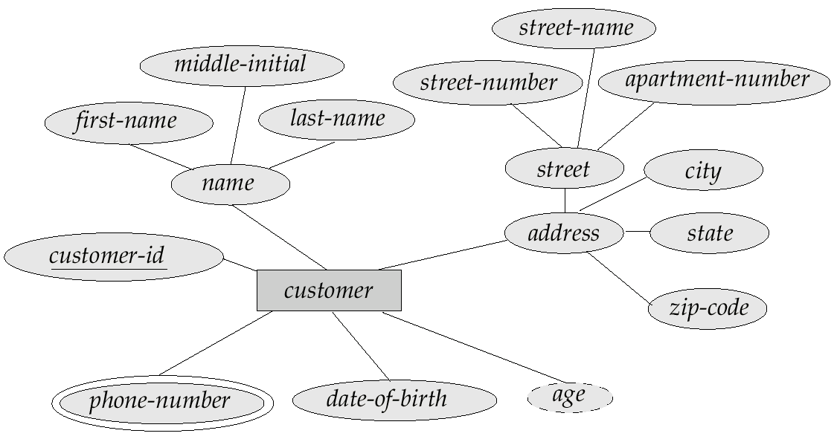
E-R Diagram With Composite, Multivalued, and Derived Attributes

Slide 17
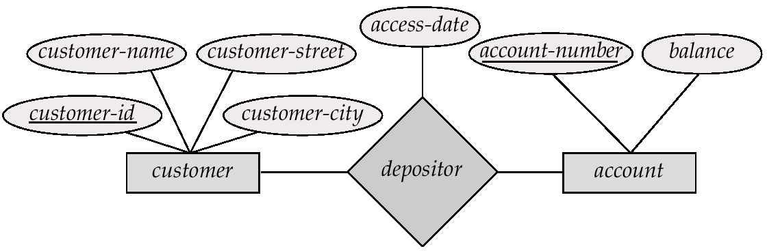
Relationship Sets with Attributes

Slide 18
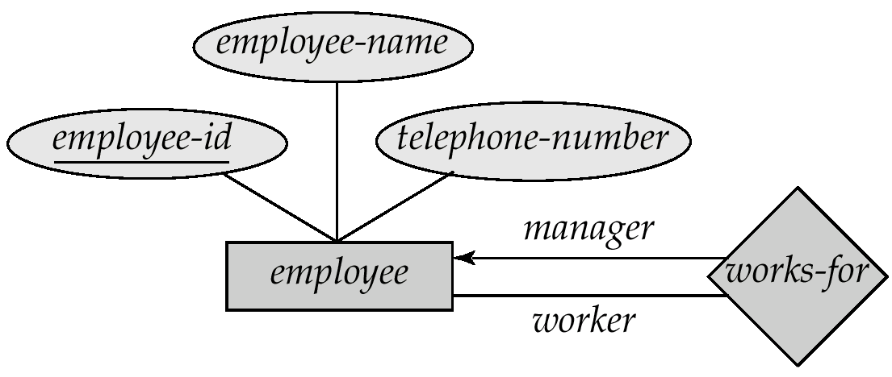
Roles
Entity sets of a relationship need not be distinct
The labels “manager” and “worker” are called roles; they specify how employee entities interact via the works-for relationship set.
Roles are indicated in E-R diagrams by labeling the lines that connect diamonds to rectangles.
Role labels are optional, and are used to clarify semantics of the relationship

Slide 19
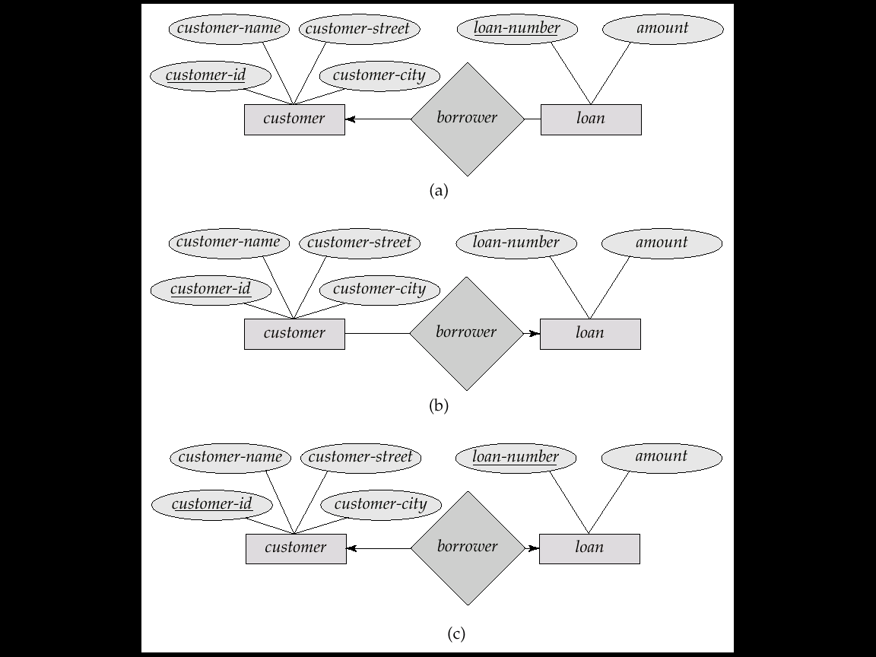
Cardinality Constraints
We express cardinality constraints by drawing either a directed line (→), signifying “one,” or an undirected line (—), signifying “many,” between the relationship set and the entity set.
One-to-one relationship:
One-to-many relationship:
Notes:
One-to-one relationship:
A customer is associated with at most one loan via the relationship borrower
A loan is associated with at most one customer via borrower
In the one-to-many relationship a loan is associated with at most one customer via borrower, a customer is associated with several (including 0) loans via borrower

Slide 20
Cardinality Constraints (Cont.)
Many-to-one relationship:
Many-to-many relationship:
Notes:
In a many-to-one relationship a loan is associated with several (including 0) customers via borrower, a customer is associated with at most one loan via borrower
In a many-to-many relationship:
A customer is associated with several (possibly 0) loans via borrower
A loan is associated with several (possibly 0) customers via borrower

Slide 21
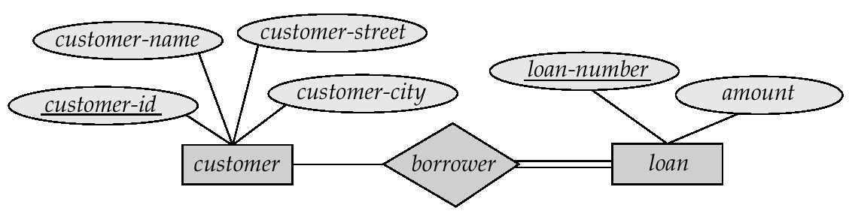
Participation of an Entity Set in a Relationship Set
Total participation (indicated by double line): every entity in the entity set participates in at least one relationship in the relationship set
E.g. participation of loan in borrower is total
every loan must have a customer associated to it via borrower
Partial participation: some entities may not participate in any relationship in the relationship set
E.g. participation of customer in borrower is partial
Notes:
Load (hutang/pinjaman) pasti memiliki relasi ke customer. Ga mungkin ada pinjaman tapi ga ada yg meminjam
Sebaliknya, customer (nasabah) belum pasti punya hutang atau pinjaman di bank

Slide 22
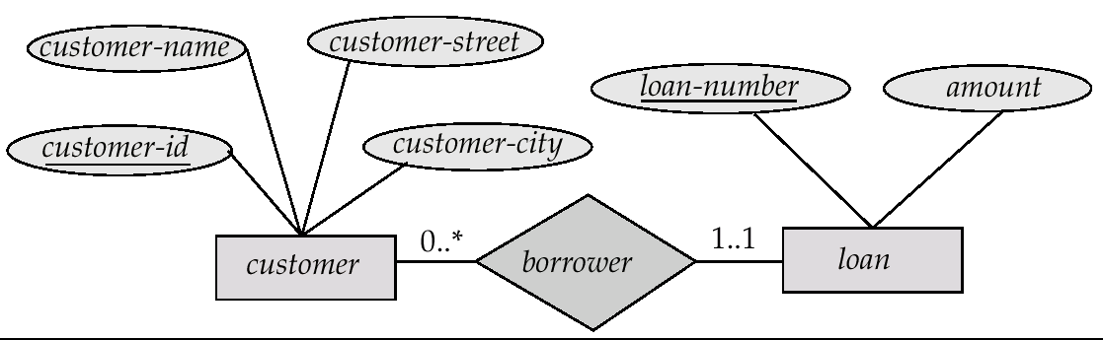
Alternative Notation for Cardinality Limits
Cardinality limits can also express participation constraints

Slide 23
Keys
A super key of an entity set is a set of one or more attributes whose values uniquely determine each entity.
A candidate key of an entity set is a minimal super key
Customer-id is candidate key of customer
account-number is candidate key of account
Although several candidate keys may exist, one of the candidate keys is selected to be the primary key.
All other candidate keys are called alternate keys.

Slide 24
Keys for Relationship Sets
The combination of primary keys of the participating entity sets forms a super key of a relationship set.
(customer-id, account-number) is the super key of depositor
NOTE: this means a pair of entity sets can have at most one relationship in a particular relationship set.
Must consider the mapping cardinality of the relationship set when deciding what are the candidate keys
Need to consider semantics of relationship set in selecting the primary key in case of more than one candidate key
Notes:
Hal ini biasanya terjadi saat relasi MANY-TO-MANY, yg nantinya menghasilkan TABEL BARU

Slide 25
Case Study 1
Sebuah perusahaan asuransi mengelola sejumlah pelanggan yang memiliki informasi No SIM, Nama, dan Alamat. Setiap pelanggan dapat memiliki sejumlah kendaraan, dan untuk setiap kendaraan perlu disimpan informasi No Kendaraan, Model, dan Tahun. Setiap kendaraan dapat terlibat dalam sejumlah kecelakaan yang dilaporkan. Untuk setiap kecelakaan, perlu disimpan informasi No Laporan, Lokasi, dan Tanggal, serta Nilai Kerusakan untuk setiap kendaraan yang terlibat di dalam kecelakaan tersebut.

Slide 26
Case Study 1 (Cont.)
Catatan Pelanggan:
NO SIM | NAMA | ALAMAT
Catatan Kendaraan:
NO KENDARAAN | MODEL | TAHUN | PEMILIK
Catatan Kecelakaan:
NO LAPORAN | LOKASI | TANGGAL | KENDARAAN TERLIBAT
 |  |  | NO KENDARAAN | SUPIR | KERUSAKAN

Slide 27
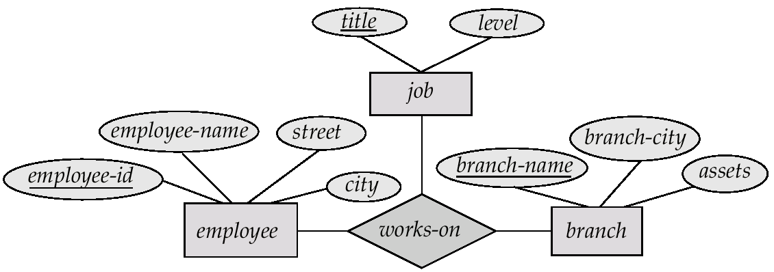
E-R Diagram with a Ternary Relationship

Slide 28
Cardinality Constraints on Ternary Relationship
We allow at most one arrow out of a ternary (or greater degree) relationship to indicate a cardinality constraint
E.g. an arrow from works-on to job indicates each employee works on at most one job at any branch.
If there is more than one arrow, there are two ways of defining the meaning.
E.g a ternary relationship R between A, B and C with arrows to B and C could mean
1. each A entity is associated with a unique entity from B and C, or
2. each pair of entities from (A, B) is associated with a unique C entity, and each pair (A, C) is associated with a unique B
Each alternative has been used in different formalisms
To avoid confusion we outlaw more than one arrow
Notes:
Alternatif pembacaan ternary:
Masing-masing entitas A berasosiasi unik dengan entitas B dan C, atau
Pasangan A dan B berasosiasi unik ke C

Slide 29
Binary Vs. Non-Binary Relationships
Some relationships that appear to be non-binary may be better represented using binary relationships
E.g. A ternary relationship parents, relating a child to his/her father and mother, is best replaced by two binary relationships, father and mother
Using two binary relationships allows partial information (e.g. only mother being know)
But there are some relationships that are naturally non-binary
E.g. works-on
Notes:
Ternary disarankan dikonvert ke binary. Contoh ternary : AYAH-IBU-Anak > Coba di ekstrak > AYAH-ANAK, atau IBU-ANAK, tapi ada resiko dia kehilangan salah satu informasi, misalnya: ada ayah ga ada ibunya, atau sebaliknya.
Tapi ada juga yg memang harus tiga, misanya: Work-On

Slide 30
Converting Non-Binary Relationships to Binary Form
In general, any non-binary relationship can be represented using binary relationships by creating an artificial entity set.
Replace R between entity sets A, B and C by an entity set E, and three relationship sets:
1. R_{A}, relating E and A 2.R_{B}, relating E and B
3. R_{C}, relating E and C
Create a special identifying attribute for E
Add any attributes of R to E
For each relationship (a_{i} , b_{i} , c_{i}) in R, create
1. a new entity e_{i} in the entity set E 2. add (e_{i} , a_{i} ) to R_{A}
3. add (e_{i} , b_{i} ) to R_{B} 4. add (e_{i} , c_{i} ) to R_{C}

Slide 31
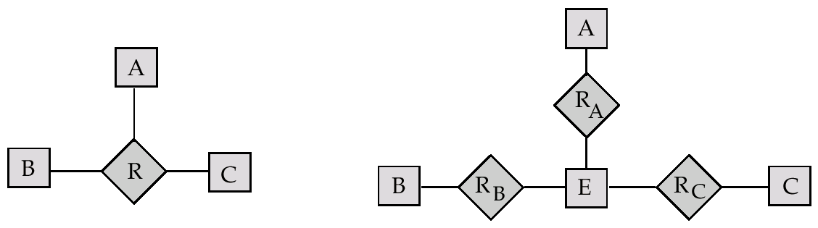
Converting Non-Binary Relationships (Cont.)
Also need to translate constraints
Translating all constraints may not be possible
There may be instances in the translated schema that cannot correspond to any instance of R
We can avoid creating an identifying attribute by making E a weak entity set (described shortly) identified by the three relationship sets

Slide 32
Design Issues
Use of entity sets vs. attributes Choice mainly depends on the structure of the enterprise being modeled, and on the semantics associated with the attribute in question.
Use of entity sets vs. relationship sets Possible guideline is to designate a relationship set to describe an action that occurs between entities
Binary versus n-ary relationship sets Although it is possible to replace any nonbinary (n-ary, for n > 2) relationship set by a number of distinct binary relationship sets, a n-ary relationship set shows more clearly that several entities participate in a single relationship.
Placement of relationship attributes

Slide 33
LATIHAN di kelas
CONTOH KASUS ERD
Pada saat mendaftar menjadi anggota perpustakaan Fakultas, dicatatlah nama, nomor mahasiswa dan alamat mahasiswa. Setelah itu mereka baru bisa meminjam buku di perpustakaan. Buku-buku yang dimiliki perpustakaan banyak sekali jumlahnya. Tiap buku memiliki data nomor buku, judul, pengarang, penerbit, tahun terbit. Satu buku bisa ditulis oleh beberapa pengarang. Tentukan entitas, atribut dan relasi dari deskripsi di atas, dengan menggambar ERDnya.

Slide 34
JAWABAN
Entitas : Mahasiswa, Anggota, Buku
Atribut : Nama, no.mahasiswa, Alamat mahasiswa, No.buku, Judul,Pengarang, Penerbit dan tahun terbit.
Relasi : Daftar dan Pinjam

Slide 35
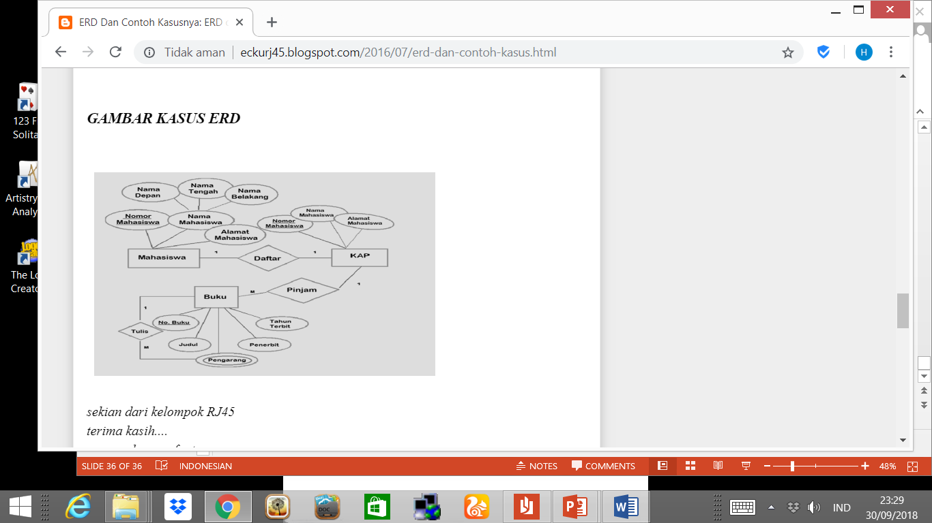
Diagram E-R

Slide 36
Case Study 2
A university consists of a number of departments. Each department offers several courses. A number of modules make up each course. Students enroll in a particular course and take modules towards the completion of that course. Each module is taught by a lecturer from the appropriate department, and each lecturer tutors a group of students

Slide 37
TUGAS CASE STUDY 2
Tentukan Entitas dan Relationshhip yang muncul pada Case Study 2
Buat Diagram E_R dari jawaban yang dipilih pada butir 1

